Slide 1
Revising Standard Mathematical Tasks Reversibility, Flexibility, Generalization (RFG) Framework
Reversibility, Flexibility, Generalization (RFG) Framework

Slide 2

Disclaimer
The contents of this presentation were developed under a cooperative agreement with the U.S. Department of Education, Office of Special Education Programs (PR Award # H326M170003). However, those contents do not necessarily represent the policy of the Department of Education, and you should not assume endorsement by the Federal Government. Tina Diamond, Ph.D. served as the project officer. This product is in the public domain. Authorization to reproduce it in whole or in part is granted. While permission to reprint this publication is not necessary, the citation should be:
Title of the Project. (date). Title of the document, Location of the Project, Author(s).
Furthermore, this presentation contains information from other public and private organizations that may be useful to the reader; these materials are merely examples of resources that may be available. Inclusion of this information does not constitute an endorsement by the U.S. Department of Education of any products or services offered or views expressed. This publication also contains hyperlinks and URLs created and maintained by outside organizations and provided for the reader's convenience. The Department is not responsible for the accuracy of this information.

Slide 3
Student Understandings
Procedural - Student can perform a computation or algorithm by following a series of prescribed steps.
Conceptual - Student understands the basis of why a computation or algorithm works. They can apply it later without reteaching. Student can identify, describe, and explain a big idea related to a topic or a class of problems. They see connections between and among ideas.
Problem solving - Student can solve a problem when there is no specific solution pathway or algorithm.

Slide 4
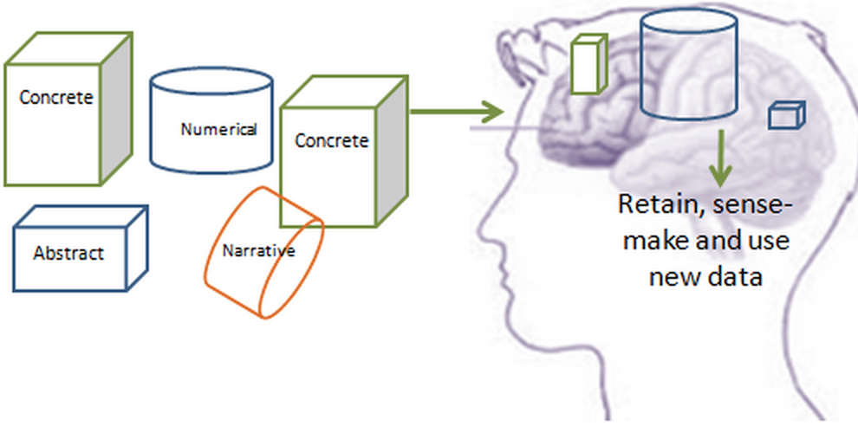
Structuring Information: Challenging for Students

Slide 5
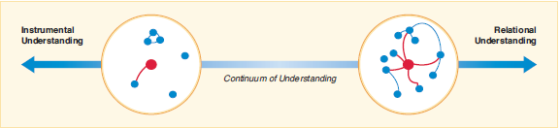
Student Learning Looks Very Different!
(Skemp, 1987).

Slide 6
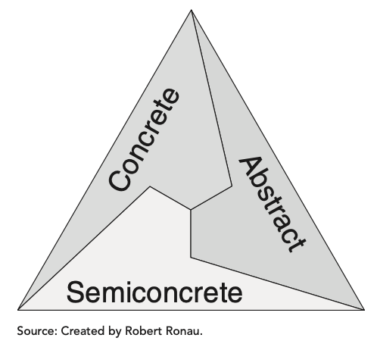
Factors that Affect Student Learning
Connections within and across topics
Multiple representations

Slide 7
Making Mathematical Connections
Reframing Standard tasks that are typically procedural
Three types of tasks will be discussed
Reversibility
Flexibility
Generalization

Slide 8
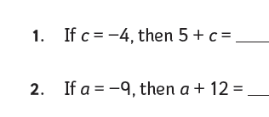
Standard Task
Solve and think about the ‘thinking’ that it requires:

Slide 9
What is a Reversibility Question?
In a reversibility question, students are given the answer and they create the problem.

Slide 10
Reversibility Task
Write an expression with one variable such that if the variable = –4, the value of the expression is 1.

Slide 11


Student Responses
$$x=−4$$
5 + $x$ = 1
2$x$ + 9 = 1
$$\frac{x}{−4}=1$$
$$k=−4$$
$k$ + $5$ = 1
2$k$+ 9 = 1
3 $k+13=1$

Slide 12


Debriefing Questions
What do you notice about 5 + x and k + 5?
What do you notice about:
k + 5
2x + 9
3x + 13
4x + 17
5x + 21?
What do you notice about 2 + x + 3 and 5 + x?
$$\text{5 +} x$$
K + 5
8 + 2$x$ + 1
5 + 6m + 18
p ÷ (-4)
5$x$ + 21
2h ÷ 4 + 1 + 1 + 1
10b +41
$$2x+9$$
2 + $x$ + 3
1 + $x$ + 4
$\frac{1}{2}$ $x$ + 3
13 + 3h
4$x$ + 17

Slide 13
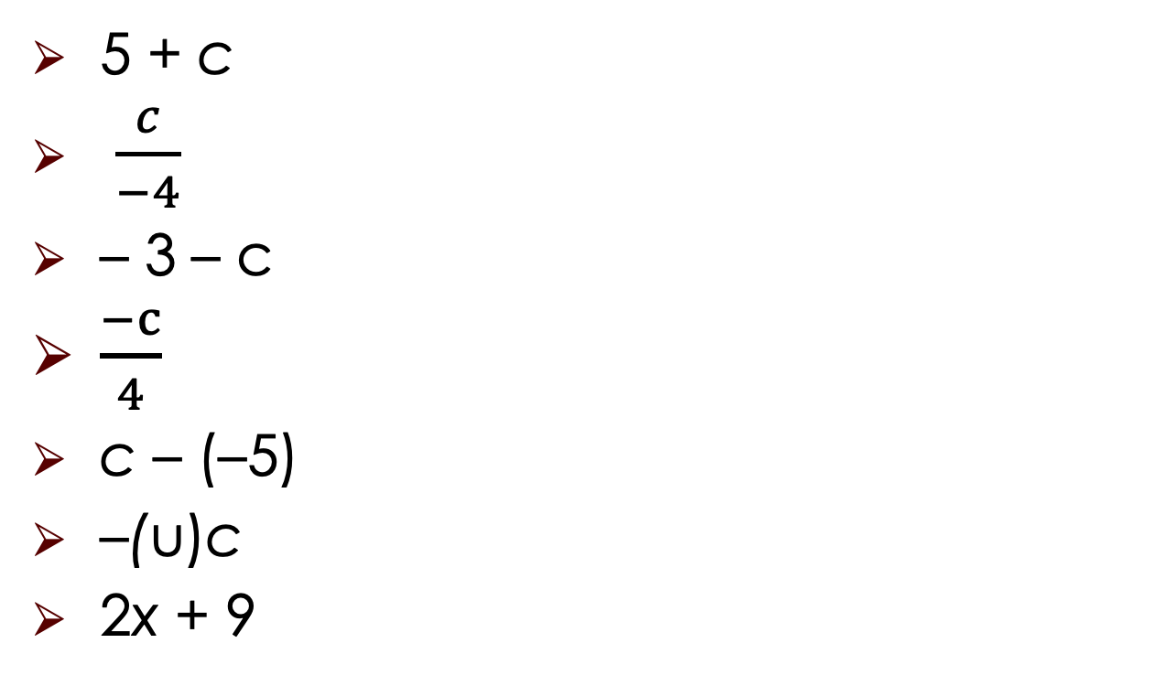
Reversibility Practice
5 + c
$\frac{c}{−4}$
– 3 – c
$\frac{−c}{4}$
c – (–5)
–(u)c
2x + 9

Slide 14
What is a Flexibility Question?
Flexibility questions support students’ development of multiple ways of finding relationships among problems, their solutions, and solution methods.
These questions help students to expand their repertoire of strategies and broaden their perspectives about particular concepts and skills by seeing connections within and across problem types.

Slide 15
Two Types of Flexibility Questions
Type 1:
Students are asked to identify how problems are alike and how they are different.
Type 2:
Students are asked to solve a problem in multiple ways.

Slide 16
Flexibility Practice
Evaluate each expression.
c = –4
6 + c
7 + c
8 + c
What do you notice?

Slide 17
What is a Generalization Question?
Generalization questions aim to create statements about patterns observed within problem classes so that students can use them to predict answers or check the reasonableness of their responses.
Generalization questions focus on specific patterns that are identified in classes of problems, or students are asked to create a specific example of a problem from a generalization.

Slide 18
Generalization Questions
May be framed like:
1. Ask students what they notice
or
2. Teachers may present a series of problems that lead to asking students what they notice.

Slide 19
Generalizability Practice
4+3=7
28+65=83
179+44=223
What do you notice?

Slide 20
Task Revision Framework
 | Expressions | Equations
Conventional form | Simplify: 6 – 2(b – 4) | Solve: b = 15 – 8
Reversibility Thinking about a problem from a different perspective, working backwards | Find an algebraic expression that simplifies to 14 – 2b. | Find an equation whose solution is 3.
Generalization 1. Identify patterns to for a generalization AND 2. Find a specific case, given a pattern | Find an algebraic expression that when simplified results in three terms. | Find a linear equation whose solution is a fraction between 0 and 1.
Flexibility 1. Solve a problem in multiple ways AND 2. Use relationships across problems to solve | If h + m = 7, what does h + m + 7 equal? | The solution to the equation 11 – x = 2(13 – 2x) is 5. What is the solution to the equation 11 – 5x = 2(13 – 10x)?

Slide 21
Let’s Look Together
Solve:
12 + a = 24
C – 14 = 17

Slide 22
12 + A = 24
Find an equation with one variable whose solution is 12. (reversibility)
3x – 2 = 22 + x
12 + a = 24
13 + a = 25
14 + a = 26

Slide 23
Getting Started with Your Students
Explicitly teach students how to respond to these questions by modeling and using “think alouds.”
Provide opportunities for students to talk with a partner.
or
In a small group to formulate an answer (e.g., Think-Pair-Share).
Provide guiding, generic questions.
When students get stuck, provide prompts such as:
What is the first step?
What model can help you figure out the answer?
What step of the strategy is causing you difficulty?

Slide 24
Think-Pair-Share (T-P-S)
T-P-S engages students as they think about and formulate responses to questions.
Think: Students think independently about the reversibility, flexibility or generalization question.
Pair: Students share their thinking with their partner.
Share: Students share their thinking during a whole-class discussion.

Slide 25
Generic Questions: Reversibility
What is/are the problem(s) you can identify for the answer?
How can you model or show (through manipulatives, pictures, number lines) how to solve the problem to arrive at the given answer?
Would it help to create a diagram? Make a table? Draw a picture? Make a model?

Slide 26
Generic Questions: Flexibility
Have we solved a problem that is similar (or different) to this one?
How can you use what you know about this problem to solve the new problem?
How is this solution or strategy method similar
to . . . ?

Slide 27
Generic Questions: Generalization
What patterns do you see?
What conjectures can we make about our observation?
Which of the representations we have used works for this problem?
What is a strategy that you have learned that can be used to solve the problem?

Slide 28
References
Dougherty, B., Bryant, D. P., Bryant, B. R., Darrough, R. L., & Pfannenstiel, K. H. (2015). Developing Concepts and Generalizations to Build Algebraic Thinking: The Reversibility, Flexibility, and Generalization Approach. Intervention in School and Clinic, 50(5), 273–281. https://doi.org/10.1177/1053451214560892
Skemp, R. (1987). The Psychology of Learning Mathematics, The Penguin Press.

