Slide 1
Job-Embedded Coaching
Professional Development
Presented by Instructional Research Group

Slide 2

Disclaimer
The contents of this presentation were developed under a cooperative agreement with the U.S. Department of Education, Office of Special Education Programs (PR Award # H326M170003). However, those contents do not necessarily represent the policy of the Department of Education, and you should not assume endorsement by the Federal Government. Tina Diamond, Ph.D. served as the project officer. This product is in the public domain. Authorization to reproduce it in whole or in part is granted. While permission to reprint this publication is not necessary, the citation should be:
Title of the Project. (date). Title of the document, Location of the Project, Author(s).
Furthermore, this presentation contains information from other public and private organizations that may be useful to the reader; these materials are merely examples of resources that may be available. Inclusion of this information does not constitute an endorsement by the U.S. Department of Education of any products or services offered or views expressed. This publication also contains hyperlinks and URLs created and maintained by outside organizations and provided for the reader's convenience. The Department is not responsible for the accuracy of this information.

Slide 3
Aspects of the Coaching Model
The Coaching Relationship
Job-Embedded
Addresses Specific Teaching Behaviors
Addresses Specific Student Behaviors
Coaching Process

Slide 4

The Coaching Relationship
Success of coaching depends on the coach to teacher relationship
Human Touch
Build Trust
Low Pressure
Treat the teachers as professionals

Slide 5
Tips to Accomplish This
Confidentiality
Timely response
Follow Through
Socialize
Coffee and doughnuts!!
Collaborative vs. Evaluative
Non-verbal language
Active listening

Slide 6
Job-Embedded Coaching
Scheduling
Determine what is the best schedule for teacher and coach
What time and day of the week works best
Determine best ways to engage in a coaching session
phone
in person
Immediate debrief after classroom observation

Slide 7
Job-Embedded Coaching (cont)
No “extras”!
It should fit into current curriculum
Grounded in day-to-day teaching practice
Designed to enhance teachers’ content-specific instructional practices with the intent of improving student learning
School- or classroom-based
Integrated into the workday

Slide 8
What We are Looking for During the Observations
Using correct mathematical language and vocabulary
Conceptually and procedurally accurate explanations
Mathematically correct representations with the materials
Providing opportunities for students to explain
Using prompting questions to elicit student explanations
Supporting students’ explanations
Students’ grasp of the content
Rapport with students

Slide 9
Sample Teaching Behavior Protocols
Math Summary Ratings (5-point Likert Scale)
Adherence to the steps of the TransMath lesson outlined in the Teacher Manual.
Clarity in conveying the lesson goals.
Supports students’ explanations.
Uses manipulatives (e.g., C-Rods) and visual representations (e.g., number lines) correctly.
Maintains a positive rapport with the students.
Perception of students’ grasp of the content.
Uses clear, mathematically correct language.
Overall rating of the lesson.

Slide 10
Coaching Process
Protocol includes teaching behaviors of interest
Coach takes copious field notes on teacher/facilitators behavior
Coach analyzes field notes and generates:
Post-observation Reflections
List at least 2 strengths of the lesson. “Kudos” remarks.
Provide up to 3 weaknesses of the lesson. “Food For Thought”.
Provide up to 3 suggestions for improving future lessons.
Notes:
Three “Kudos” Statements which are statements that address aspects of the lesson that were implemented well.
No more than three “Food for Thought” statements addressing aspects of the lesson than need improvement.
The Food for Thought statements are prioritized from serious to less serious issues.

Slide 11
How PD Addressed the Suggestions
For Suggestion 1: Using think-alouds to model their thinking to students so they can see a model explanation.
For Suggestion 2: Discuss critical features of algebraic reasoning in PD – what to cut & what is critical.
For Suggestion 3: Using some benchmark data to group students into more homogenous groups for skills needed in order to structure the classroom as a co-teaching environment (already a requirement at the school). Classes were divided into three groups based on their pretest scores on STAR.

Slide 12

Responsive Coaching
Teachers know the expectations – manipulatives, supporting explanations, using student-level data to inform teaching decisions, etc.
After coaching sessions, they make
requests for future PD on some of the
things that were identified as “food for thought”.

Slide 13
Two Coaching Methods
Teacher Focused Coaching (TFC)
See Handout 8a & 8b
Modified Model to Student Focused Coaching for Resistant Teachers (SFC)
See Handout 8c & 8d

Slide 14
Teacher-Focused Coaching (TFC)
Coaching model that focuses on data that addresses teaching behaviors.
Teacher’s instructional behaviors provide the cornerstone of the coaching process.
The premise behind the model: Improving teachers’ instructional behaviors increases student learning.

Slide 15
Student-Focused Coaching (SFC)
Coaching model that focuses on data that reflect students’ response to teaching behaviors.
Students oral and written responses during instruction provide the cornerstone of the coaching process.
The premise behind the model: Students’ understandings and misunderstandings of the content serve as the basis for improving teachers’ instructional behaviors that increase student learning.

Slide 16
Common Features of Both Models
Take detailed field notes during the observation.
Refer to field notes to rate the aspects of the lesson on an 8-item, 5-point Likert scale.
Provide justification for the rating in the notes section for each item.
Review field notes and rating to craft at least two strength and no more that three weaknesses of the lesson.

Slide 17
Differences Between TFC and SFC
TFC
SFC
The strengths and weaknesses focus on teacher behaviors.
The recommendations focus on teaching behaviors that will improve instruction and students’ understanding of the math concepts.
The strengths and weaknesses focus on student behaviors.
Students’ understandings and misunderstanding serve as the bases for making instructional recommendations to improve students’ understanding of math concepts.

Slide 18
Example of TFC Coaching Process
Lesson Objective: Students will compare decimal numbers.
Field Notes: The teacher consistently used inaccurate mathematical language. Examples:
Using bigger and smaller rather than greater than and less than.
Using “point” when reading decimal numbers (reading 3.5 as three point five rather than three and five tenths).

Slide 19
Example of TFC Coaching Process (cont.)
During the post observation conference, the coach provided:
Specific examples of the inaccurate mathematical language.
Correct mathematical language for each example.
Rationale:
These terms are used at all grade levels.
Using these terms will help avoid students’ confusion in the future.

Slide 20
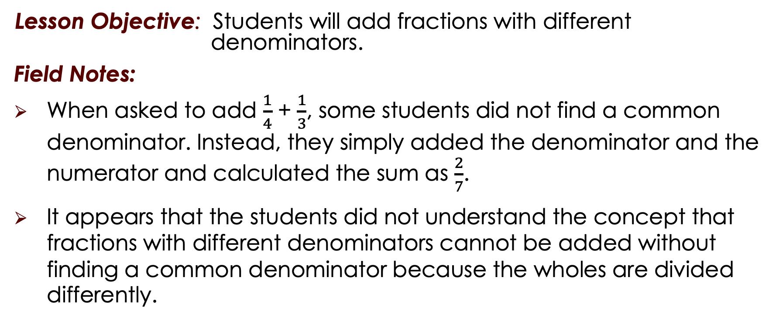
Example of SFC Coaching Process
Lesson Objective: Students will add fractions with different denominators.
Field Notes:
When asked to add $\frac{1}{4}$ + $\frac{1}{3}$, some students did not find a common denominator. Instead, they simply added the denominator and the numerator and calculated the sum as $\frac{2}{7}$.
It appears that the students did not understand the concept that fractions with different denominators cannot be added without finding a common denominator because the wholes are divided differently.

Slide 21
Example of SFC Coaching Process (cont.)
During the post observation conference, the coach:
Stated that students made this error during whole class instruction and during guided practice.
To clear up students’ confusion, the coach recommended that the teacher review the concept of finding common denominators using C-Rods and eventually the number line to show why denominators (the whole) need to be the same when adding fractions.

Slide 22

Modifications to Model
Teachers don’t receive coaching well
Provide a lot of praise for what they did well
Rather than discuss three areas that need improvement (Food for Thought statements), focus on only one
Teachers receive coaching well, but say they “can’t do (insert excuse)”
Plan the lesson with the teacher
Model a lesson
Co-teach the lesson
Work on other areas to help troubleshoot

Slide 23

Tips for Hiring Coaches
Detail-oriented
People skills
Knowledge in the area of instruction in which they
are coaching
Knowledge of the tenets of effective instruction
Experience in classroom observations
Classroom teaching experience
Experience with successfully working with adults
Served in a leadership capacity (e.g. coach, mentor teacher, student teacher supervisor, grade-level team leader)

Slide 24
References
Woodward, J., & Stroh, M. (2015). TransMath: Fluency with rational numbers (3rd ed.). Dallas, TX: Voyager Sopris Learning.
Hasbrouck, J. &Michel, D. (2022) Student Centered Coaching: The instructional coach’s guide to supporting student success through teacher collaboration. Paul H. Brooks, Baltimore, MD, United States.

